Slide 1

Deducing Investment Opportunity for a Real Estate Investment Company
Where to invest in Queens County, New York
By: Tamjid Ahsan
Date: June 23, 2021, 05:00 PM [DST]

Slide 2

INDUSTRY OVERVIEW
New York City is among the most expensive and competitive housing markets in the USA.
Experts predicting strong property appreciation.
Home prices are still low compared to where they were last year.
52% price appropriation as per Zillow Home Value Index.
Notes:
New York City is among the most expensive and competitive housing markets in the USA. It was impacted severely by the COVID-19.
NYC is a buyer's real estate market and buyers may have an opportunity to get some heavy discounts.
Many industry experts have been predicting a strong property appreciation in New York starting from 2021.
Home prices are still low compared to where they were last year, just before the pandemic hit New York City. Most buyers aren't paying sellers' asking prices.
Since 2012, the NYC home values have appreciated by nearly 52% as per Zillow Home Value Index.
This makes New York as one of the best real estate market for homes to get into.
The house prices are relatively low
High buyer power
Huge inventory of homes
Projected uptrend in price leading to higher return on investment.

Slide 3
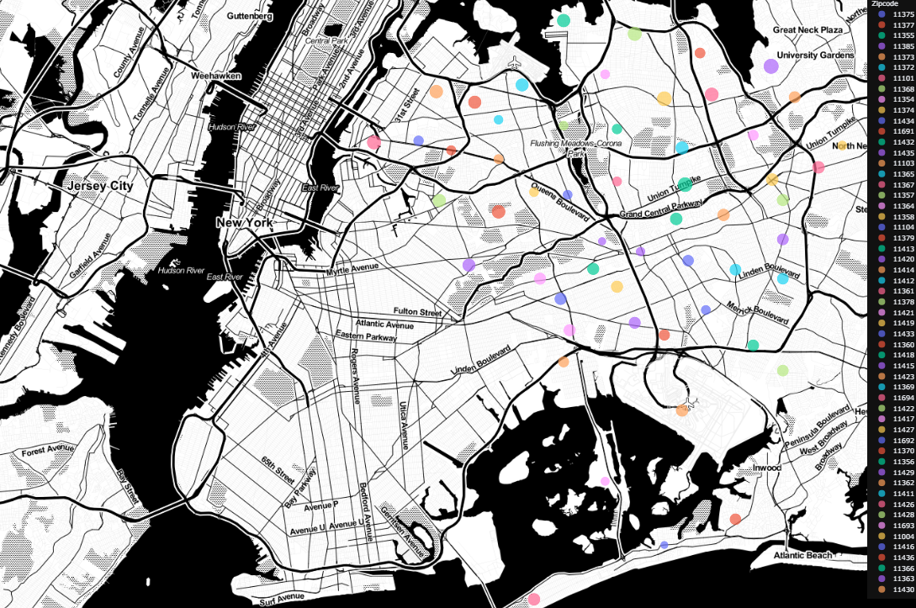
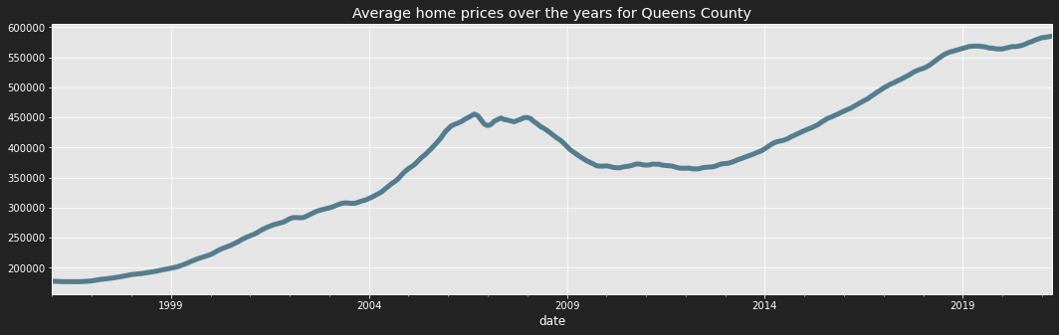
Queens County
This makes New York as one of the best real estate market for homes to get into.
The house prices are relatively low
High buyer power
Huge inventory of homes
Projected uptrend in price leading to higher return on investment.
Notes:
Enjoying a recent bull run.
Recovered well beyond the financial crisis of 2009

Slide 4
BUSINESS PROBLEM
XYZ, Inc. LLC is a (read: fictional) private equity investment company based on Queens, New York.
They want to invest in the housing market for three years.
They want to isolate and invest in properties with the highest return on investment potential based on geographical location close to their operation base in Queens.
All 55 zip codes of Queens county of New York were considered.
This analysis will recommend top five zip codes based on return-on-investment potential.
Notes:
XYZ, Inc. LLC is a (read: fictional) private equity investment company based on Queens, New York.
They want to invest in the housing market for relatively short term, three years.
They want to isolate and invest in properties with the highest return on investment potential based on geographical location close to their operation base in Queens, as they want to cluster their investment based on location.
For this analysis, all 55 zip codes of Queens county of New York city, NY were considered.
This analysis will recommend top five zip codes with return-on-investment potential with some insights, which will aid the top management of the company to make an educated decision on where to invest.

Slide 5
METHODOLOGY
Zillow House Value dataset is used.
Data from January 1996 to April 2021
Monthly data
Several analysis techniques were used
ARIMA (autoregressive integrated moving average)
SARIMAX (ARIMA with seasonal trends)
Forecasted for three years.

Slide 6

Queens County New York
OVER THE YEARS

Slide 7
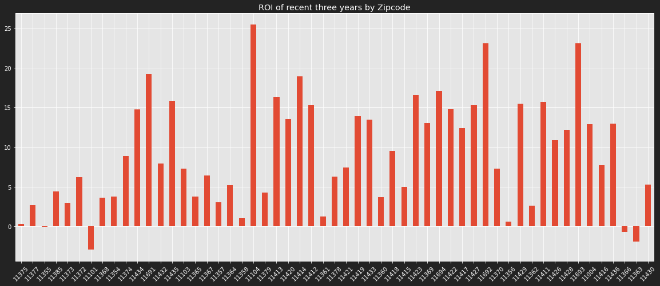
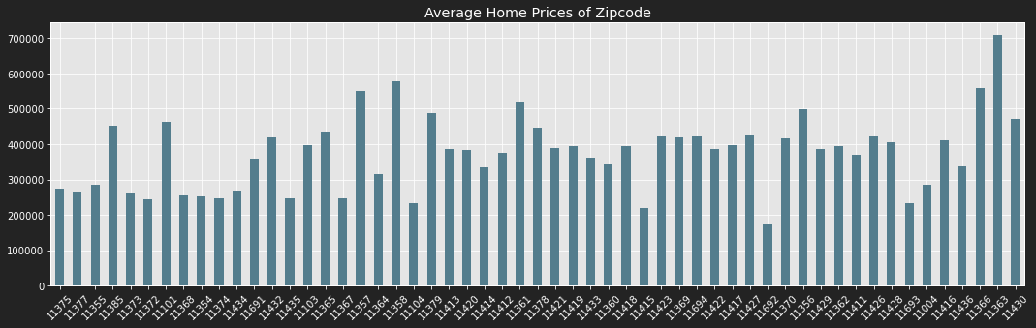
QUEENS COUNTY OVERVIEW
ROI is negative for only a few of the zip codes
11101
11436
11366
Average median value is well above 200k across zip codes.
Notes:
Rearrange plots

Slide 8
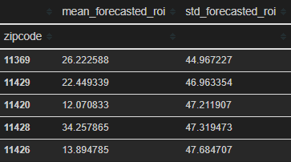
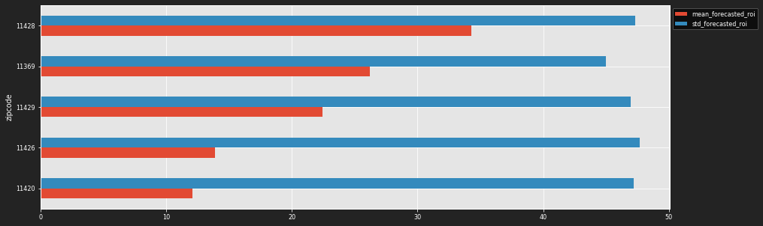
SELECTION CRITERIA
Risk:
Cost is the value on April 30, 2021.
Revenue is assumed to the mean forecasted value after three years.
Then relative standard deviation is taken of the return on investment on upper confidence level and lower confidence level respectively as a proxy of risk of investment.
Top five zip codes is isolated based on best 15 ROI and then selecting top 5 of the based on lowest risk.
Notes:
Risk:
Cost is assumed to be the last true value of the median price of the zip code, i.e., value on April 30, 2021.
revenue is assumed to the mean forecasted value after three years, i.e., 36 steps in the future.
Then standard deviation is taken of the return on investment on upper confidence level and lower confidence level respectively as a proxy of risk of investment.
Top five zip codes based on best 15 (27% of all available investment opportunity) ROI and then selecting top 5 of the based on lowest risk, i.e., the risk proxy mentioned above.

Slide 9
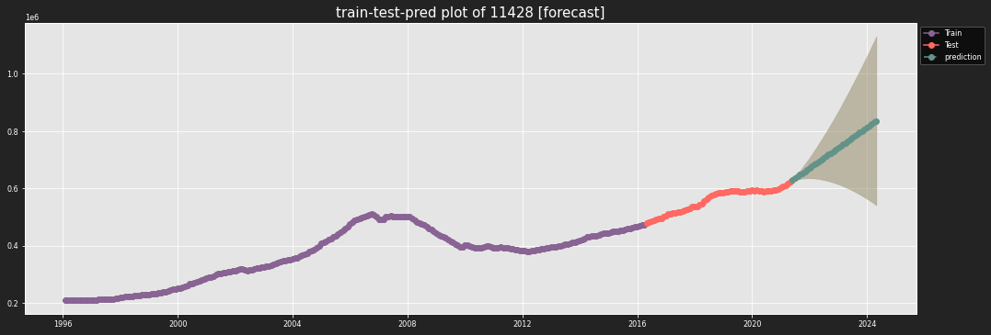
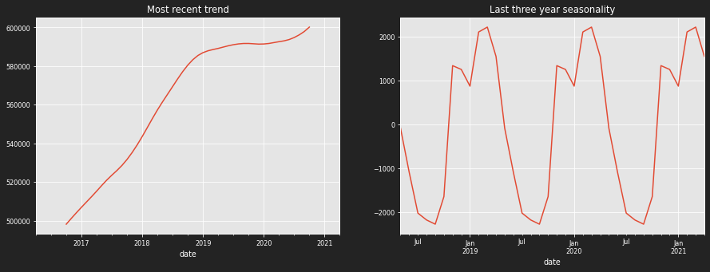
11428
Observation:
Massive uptrend since 2017
Got struck by COVID19
Huge ROI potential.
Observed ROI – 12%
Forecasted ROI | Risk | Current Value
34.26 | 47.32 | $623,049

Slide 10
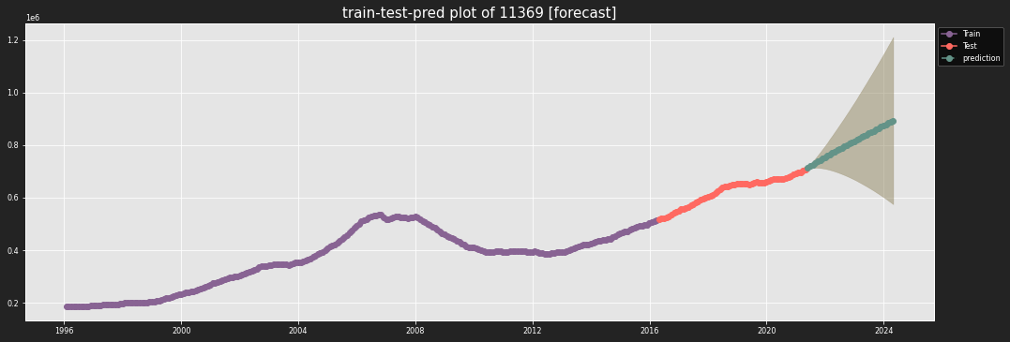
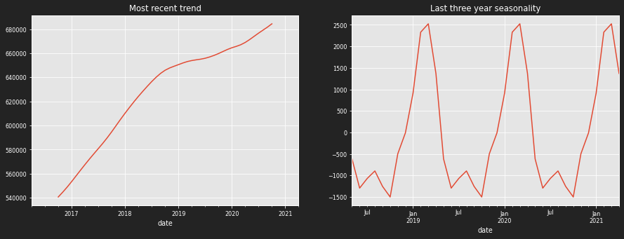
11369
Observation:
Massive uptrend since 2017
Got struck by COVID19
Substantial ROI gain potential.
Observed ROI – 13%
Forecasted ROI | Risk | Current Value
26.22 | 44.96 | $707,477

Slide 11

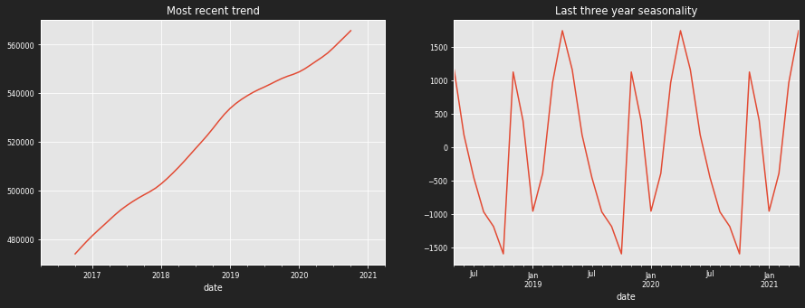
11429
Observation:
Massive uptrend since 2017
Less affected by COVID19
Observed ROI – 15%
Irregular seasonality.
Forecasted ROI | Risk | Current Value
22.45 | 46.96 | $583,710

Slide 12
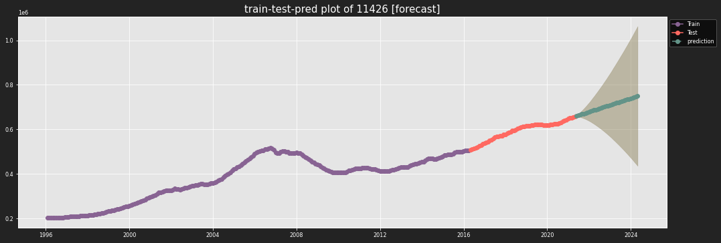
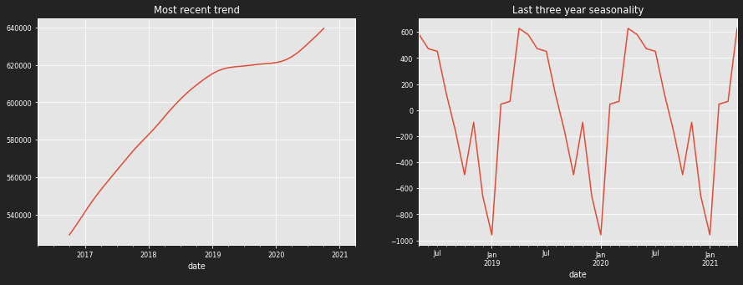
11426
Observation:
Massive uptrend since 2017
Got struck by COVID19
Good ROI potential.
Observed ROI – 11%
Forecasted ROI | Risk | Current Value
13.89 | 47.68 | $657,969

Slide 13

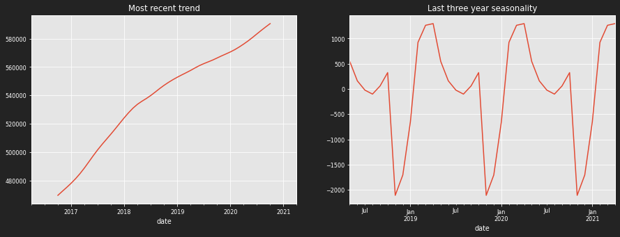
11420
Observation:
Massive uptrend since 2017
Less affected by COVID19
Good ROI potential.
Observed ROI – 14%
Forecasted ROI | Risk | Current Value
12.07 | 47.21 | $604,603

Slide 14
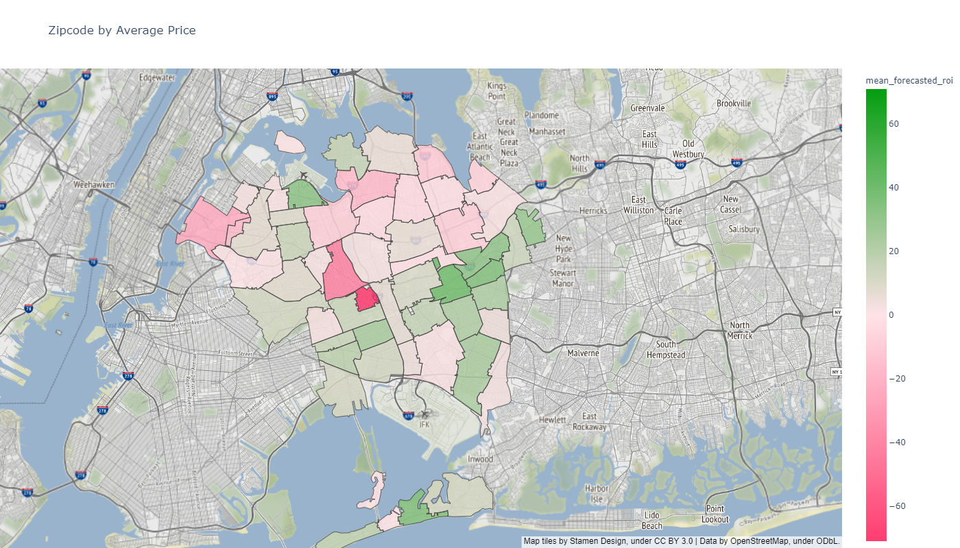
ON A MAP
Notes:
Goto dask

Slide 15
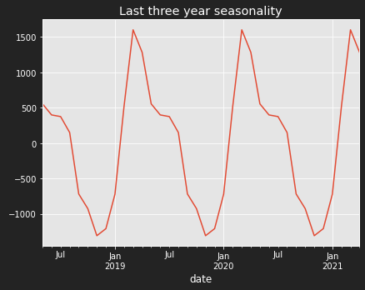
SEASONALITY
For maximum return
Sell at he beginning of a year
Buy towards the end of a year

Slide 16
RECOMMENDATION
Invest in following zip codes:
Stay away from these, they are in a bubble :
11693
11415
Zip Code | Forecasted ROI
11428 | 34.26
11369 | 26.22
11429 | 22.45
11426 | 13.89
11420 | 12.07
Rule of thumb:
Go to southeast part of Queens for good investment opportunity.
Some of the house are overvalued, and awaits correction, be careful of those houses.
For maximum return
Sell at the beginning of a year
Buy towards the end of a year
Notes:
Add roi

Slide 17

NEXT STEPS
Add variables to model, using a SARIMAX model
Interest rate
Other qualitative indicators of house value based on location, e.g., Schools.
Buyer and seller ratio
Try other machine learning models

Slide 18
THANK YOU
GitHub: @tamjid-ahsan
LinkedIn: linkedin.com/in/tamjidahsan/
Project repo: https://github.com/tamjid-ahsan/dsc-phase-3-project

Slide 19
APPENDIX

Slide 20
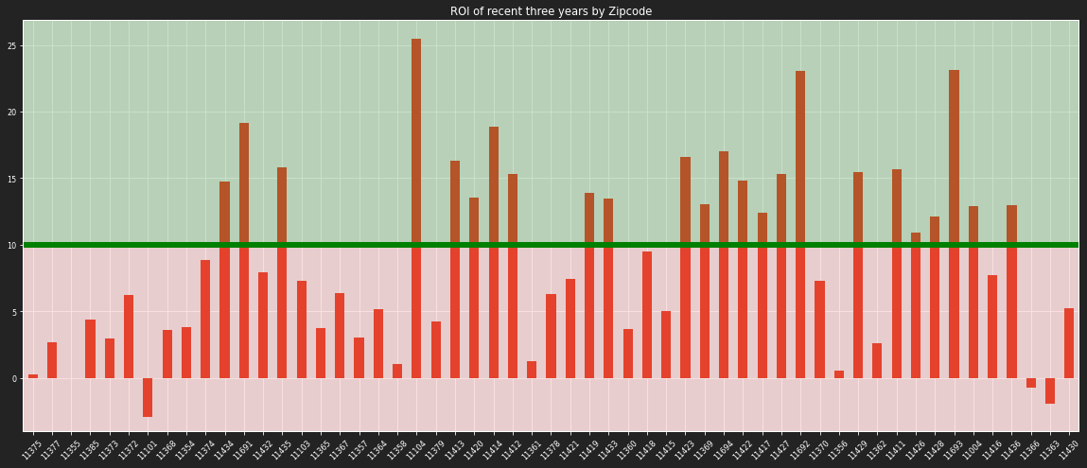
ZIPCODE SELECTION CRITERA

Slide 21

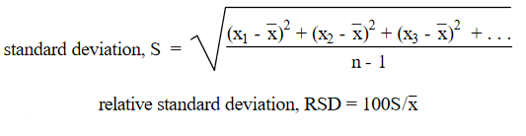
RELATIVE STANDARD DAVIATION
Standard deviation expressed in percent and is obtained by multiplying the standard deviation by 100 and dividing this product by the average.

Slide 22
SUPPORT AND RESISTANCE
Support is a price level where a downtrend can be expected to pause due to a concentration of demand or buying interest. As the price of assets drops, demand increases, thus forming the support line. Meanwhile, resistance zones arise due to selling interest when prices have increased, investors are not willing to invest in that asset beyond that price.
Once an area or "zone" of support or resistance has been identified, those price levels can serve as potential entry or exit points because, as a price reaches a point of support or resistance, it will do one of two things -
bounce back away from the support or resistance level, or
violate the price level and continue in its direction, until it hits the next support or resistance level.

Slide 23
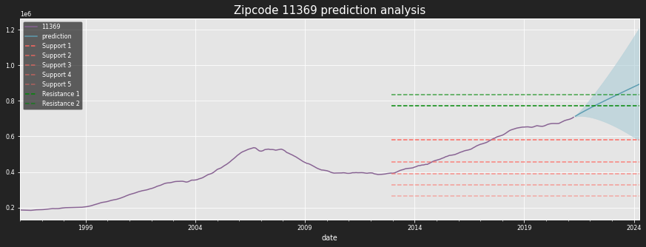
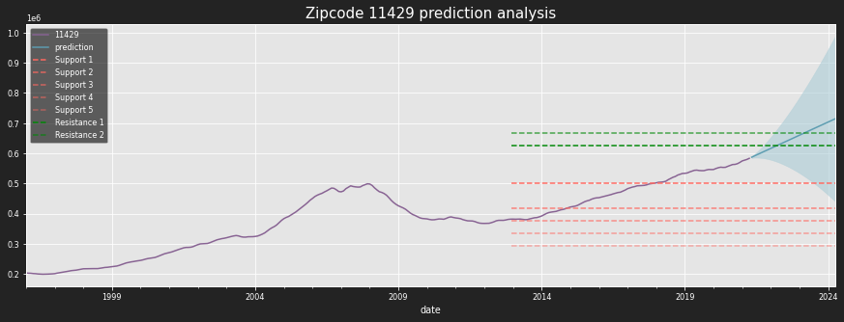
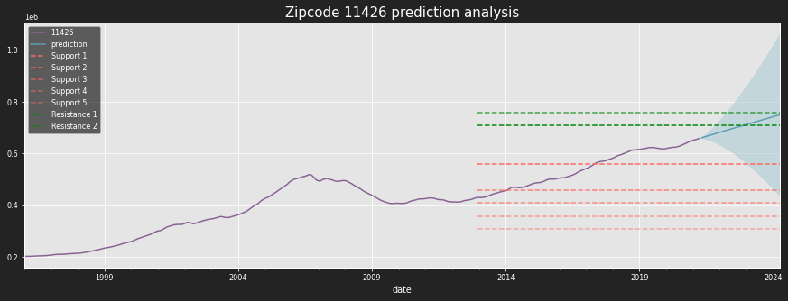
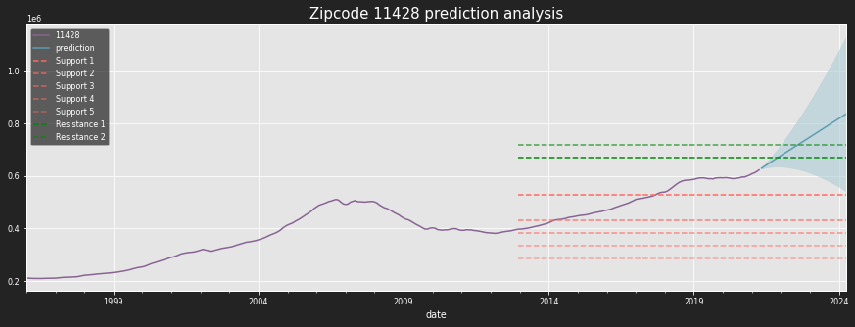
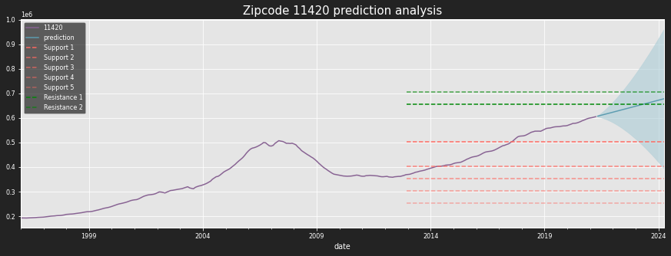
Support and Resistance
Invest in properties in these zip codes.

Slide 24
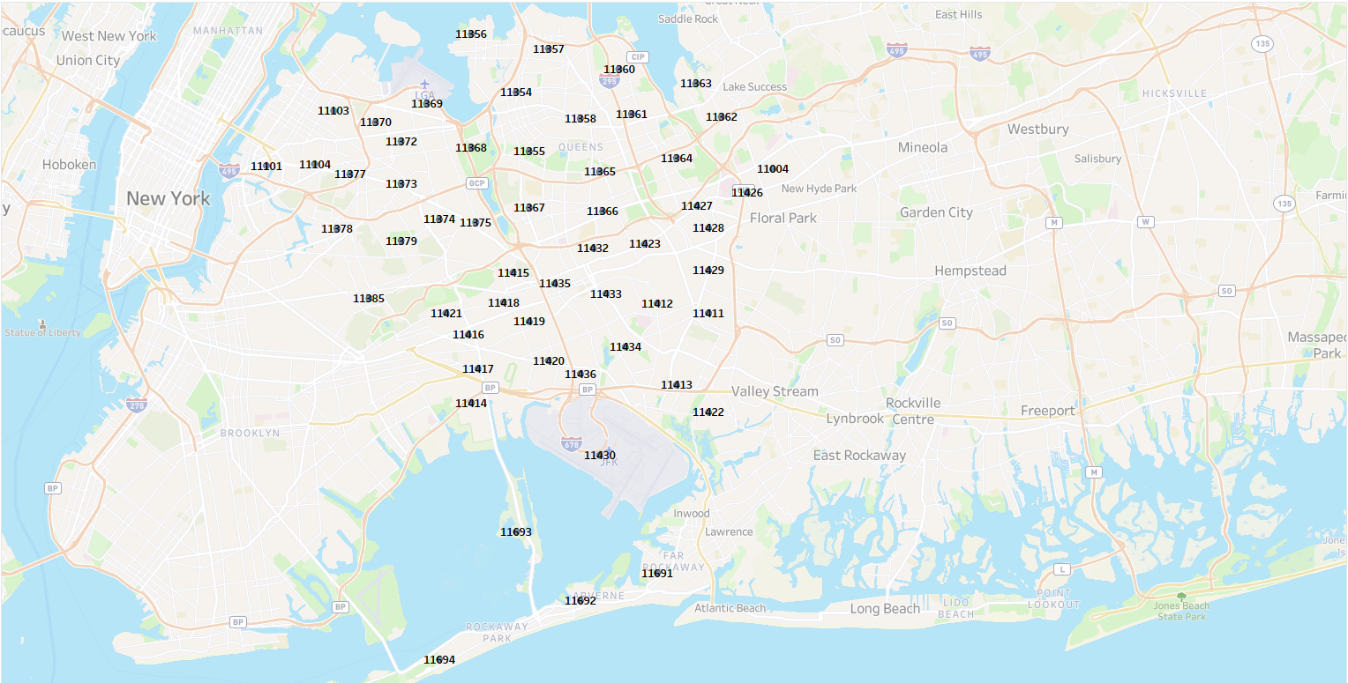
ZIP CODE Location
Image by Author, using tableau

